Slide 1
Getting Started with Node JS
By Rajdeep

Slide 2
Installation
Create Directory
Node JS : https://nodejs.org/en/download/prebuilt-installer
VS CODE : https://code.visualstudio.com/
Create a Directory named say “HelloWorld”

Slide 3
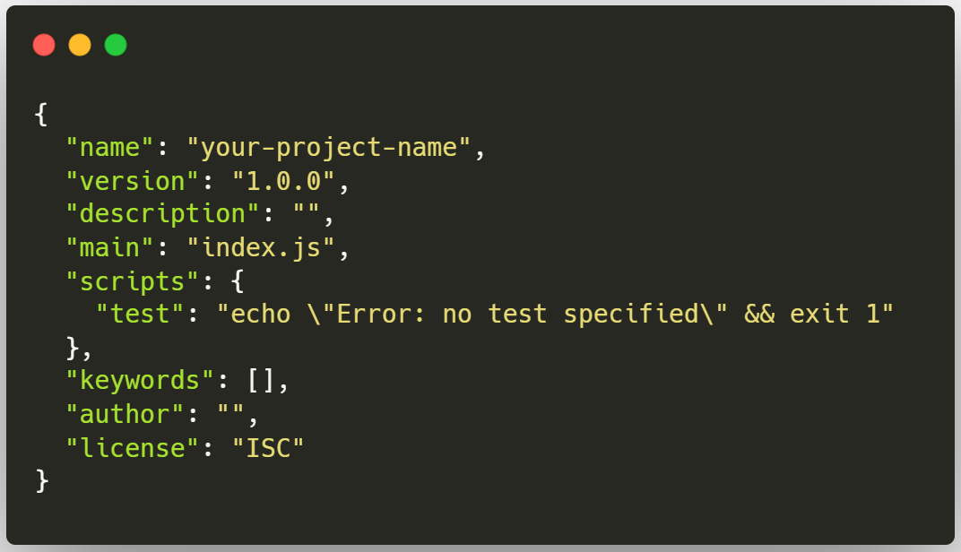
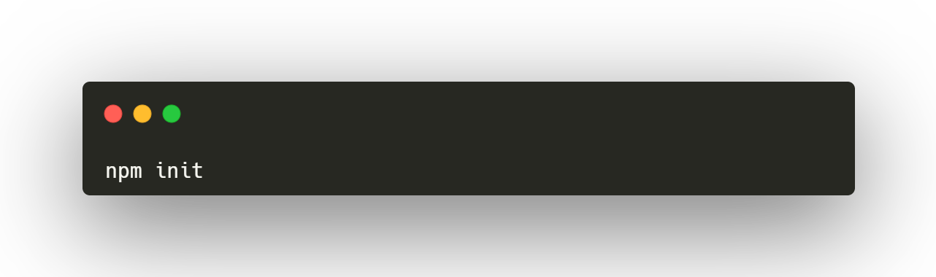
Initiating package.json
“package.json” is a crucial file in Node.js projects. It serves multiple purposes and includes various pieces of metadata about the project.

Slide 4
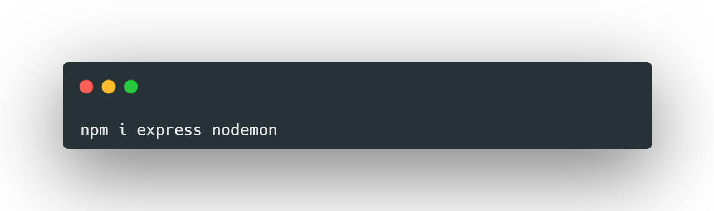
Installing packages
Express
The express package is a popular web framework for Node.js, designed for building web applications and APIs. It simplifies the process of handling HTTP requests and responses, providing a robust set of features for web and mobile applications.
Nodemon
Nodemon is a popular utility for Node.js applications that helps with development by automatically restarting the node application when file changes in the directory are detected.

Slide 5
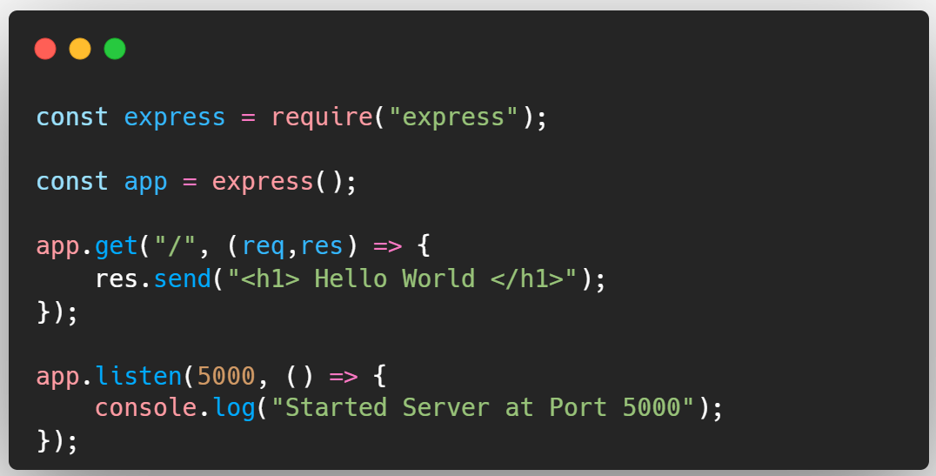
app.js
Create a file named app.js which will contain the main API logic.

Slide 6
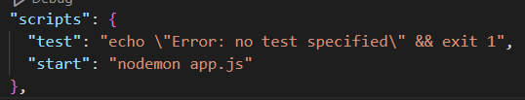
package.json
Create the Entry point of the server as follows

Slide 7
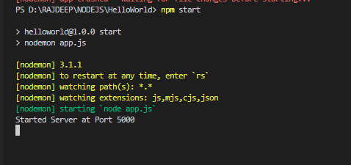
Start Server
Start Server as “npm start”

